Slide 1
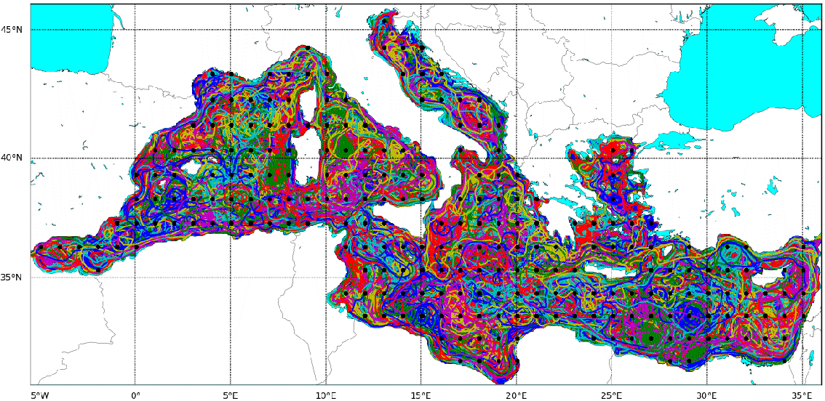
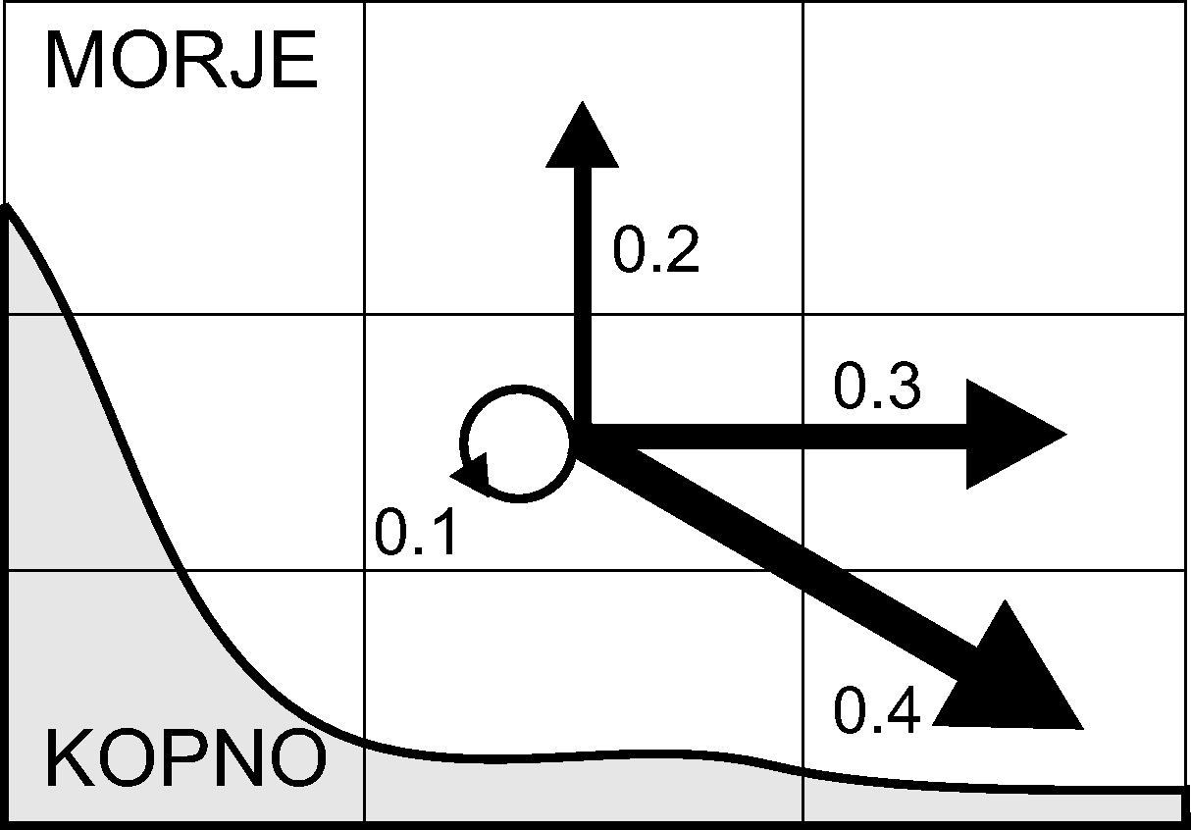
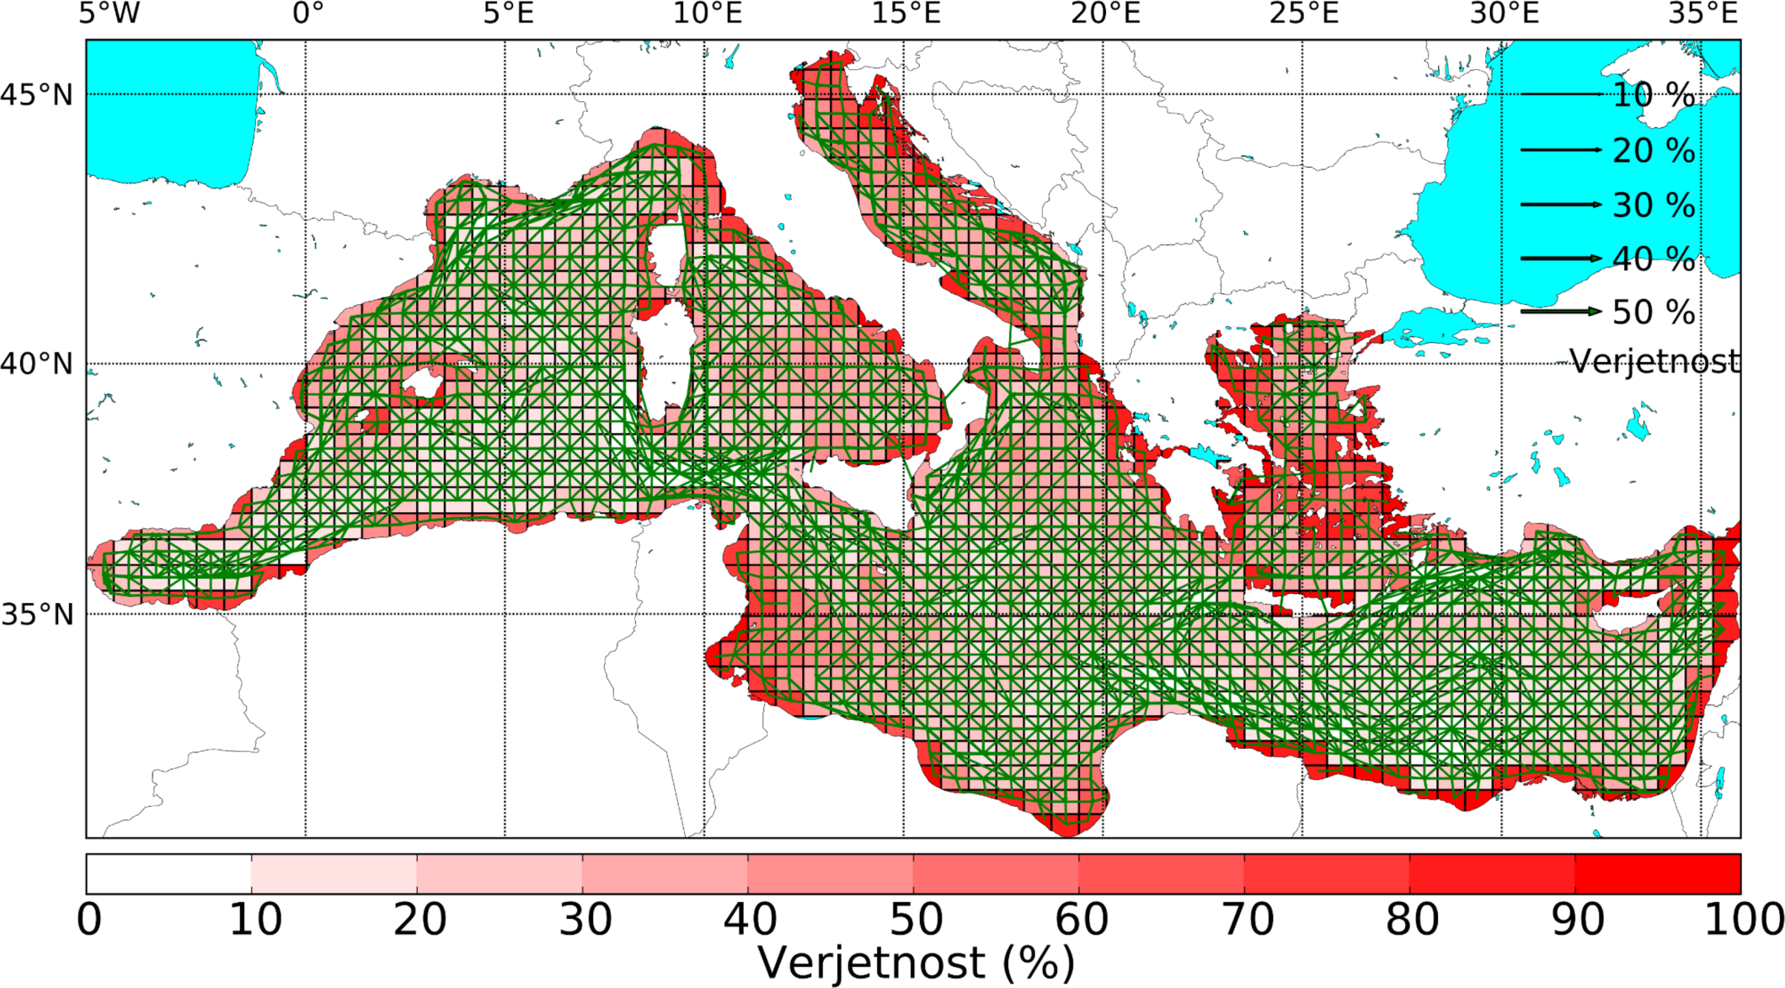
Modeliranje gibanja vodnih mas v Sredozemskem morju
1) Lagrangean tracing
2) Spatio-temporal association rules
Mediterranean Ocean Forecasting System (Tonani et al., 2008)
1999-2011
3) Multilevel directed graphs
(Petelin et al., 2013)

Slide 2
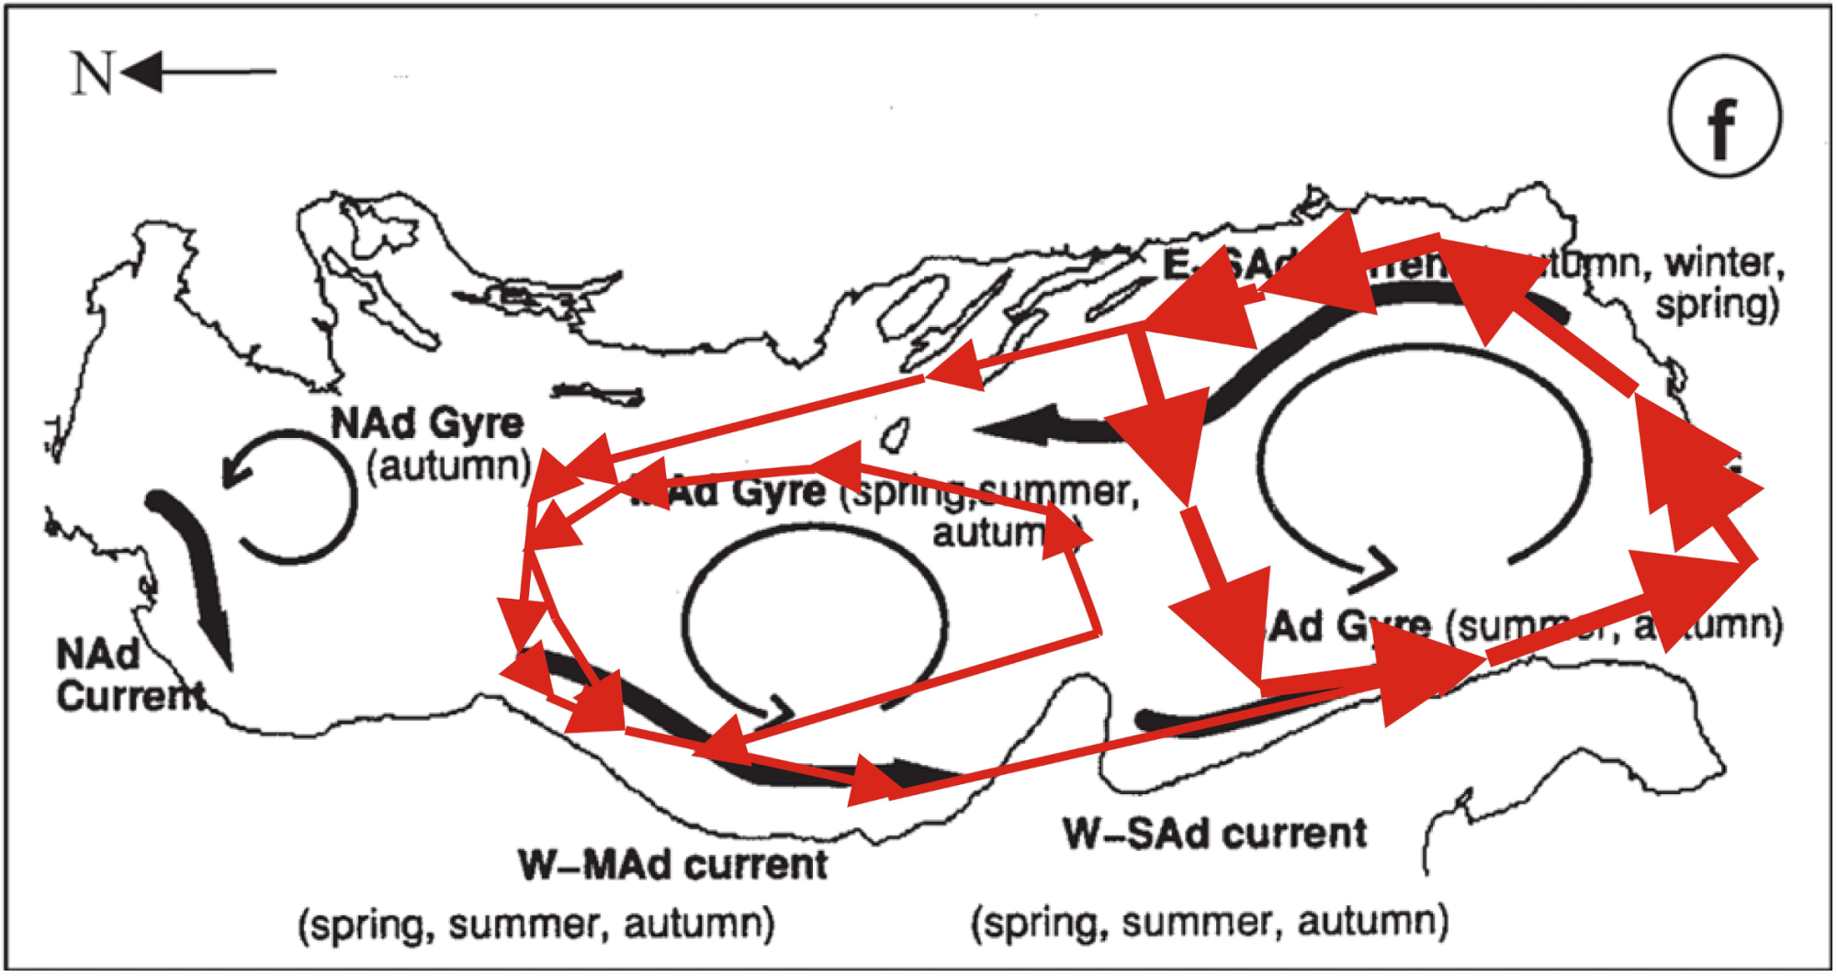
Dynamic fuzzy cycles

Slide 3
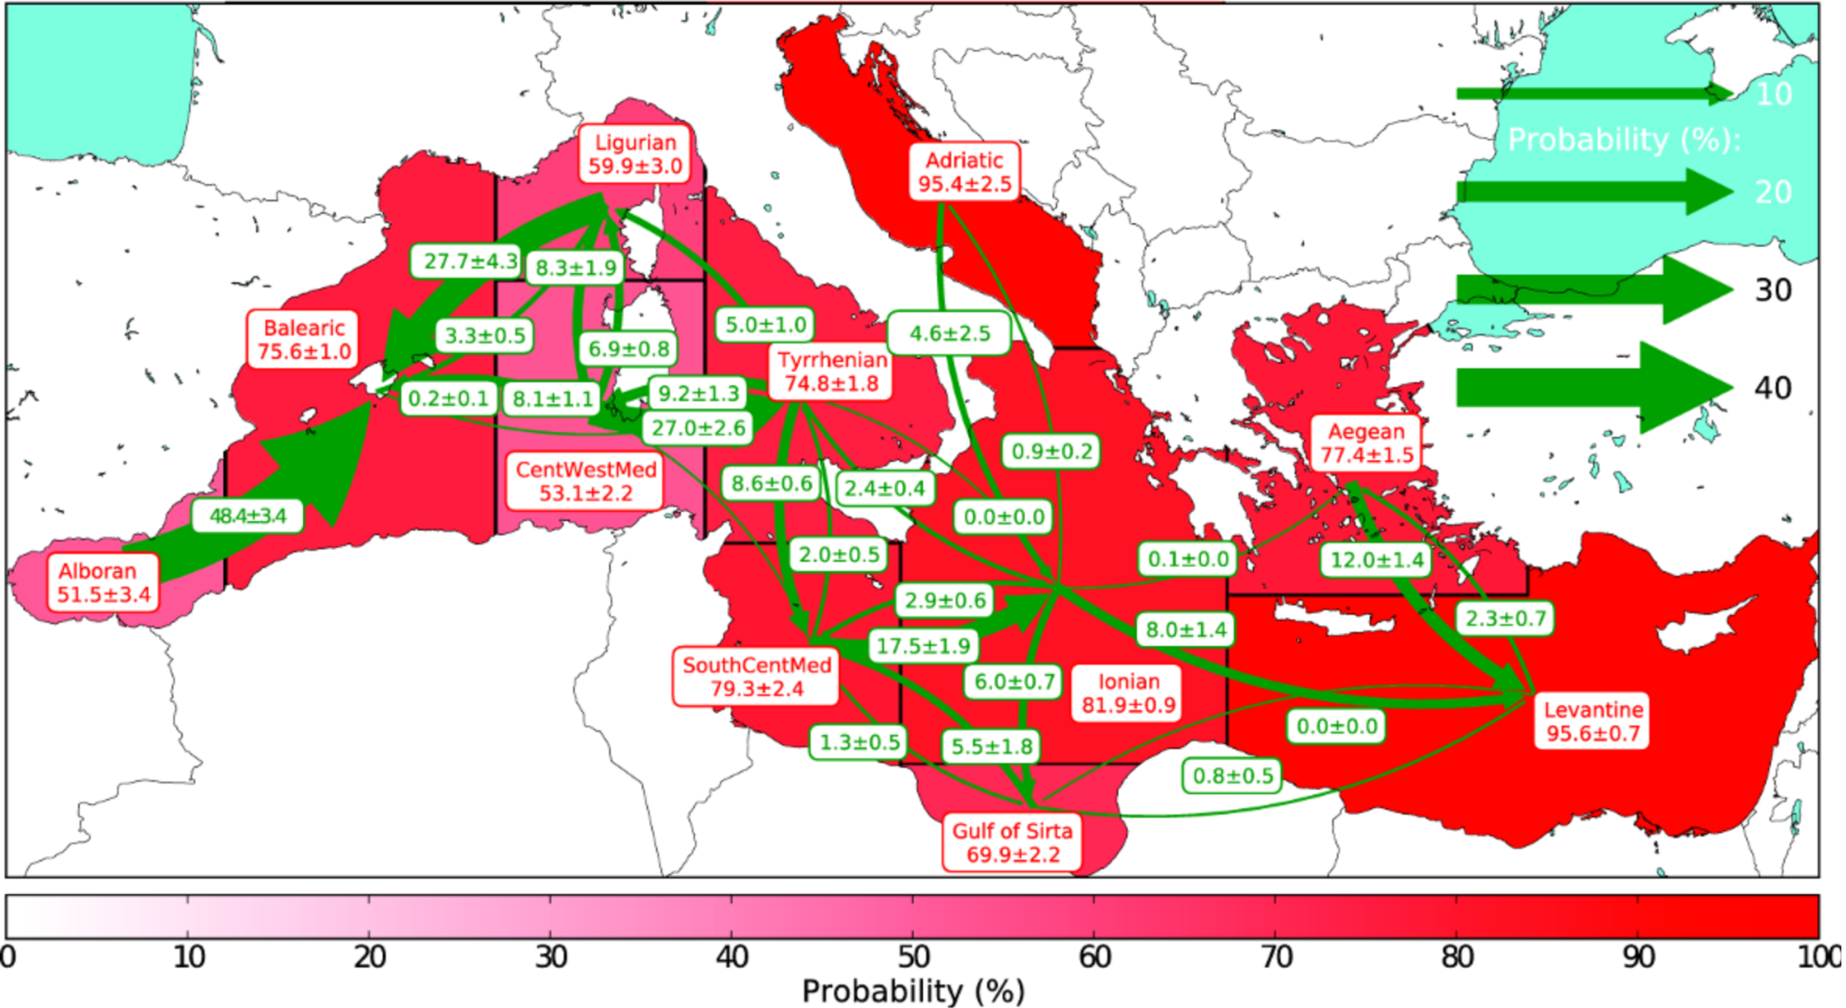
Periodical movement of water masses
(Petelin et al., 2013)
Petelin et al., 2012, In EGU General Assembly Conference Abstracts, Vienna, April 2012

Slide 4
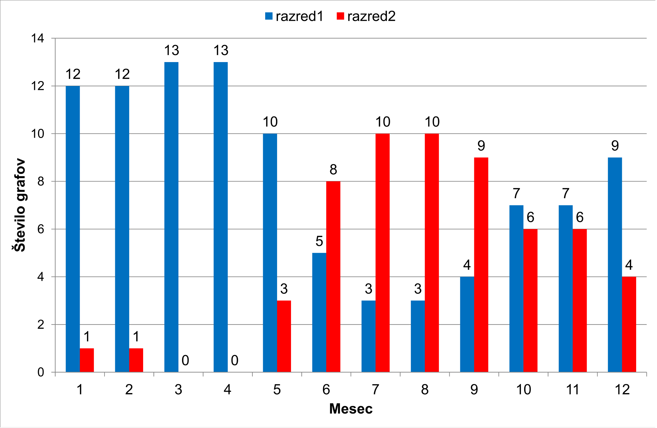
Seasonal properties of multilevel graphs
(Petelin et al., 2013)

Slide 5
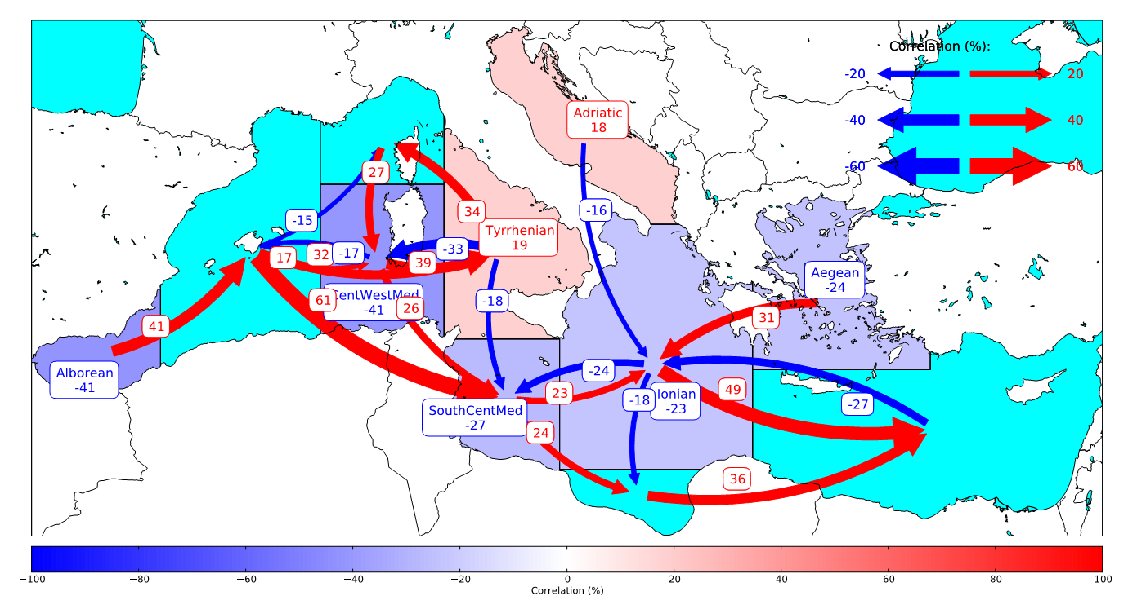
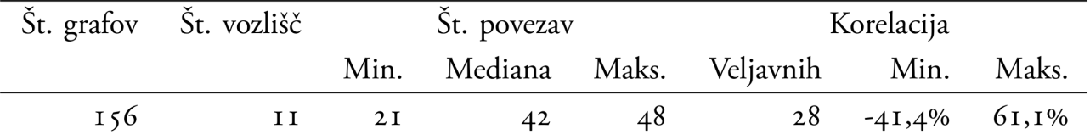
Correlation with wind energy
Petelin et al., 2012, In EGU General Assembly Conference Abstracts, Vienna, April 2012

Slide 6
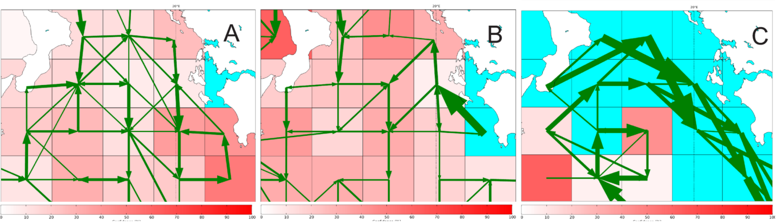
The reversal of surface circulation
Observations in Ionic sea:
Reversal of circulation:
Anticyclonic – from January 1994 till June 1997
Cyclonic from July 1997 till the end of 2006
Anticyclonic – in 2007
(Petelin et al., 2013)

Slide 7
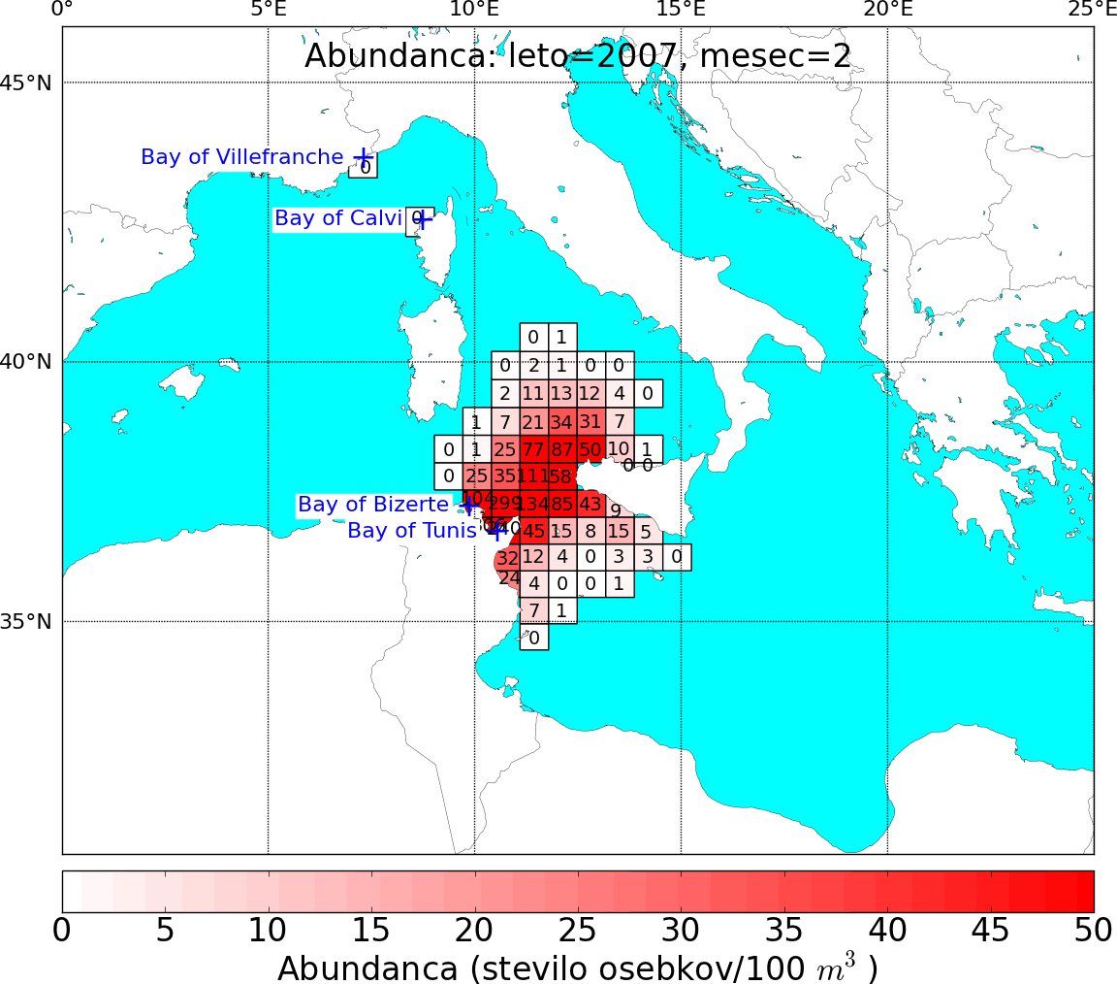
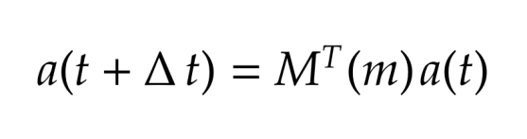
Modelling of biological species spreading
Markovprocess:
a – abundance (numerous) of biological species
M – matrix of neigborings with time interval ∆t
t – current time
m – current month
In CIESM Congress Proceedings nº40, Marseille, France, 28 Oct. - 01 Nov. 2013
Example: jellyfish(Pelagia noctiluca, Scyphozoa)

